Slide 1
Cricket Performance Insights: Visualizing Trends and Patterns Using Pandas, Matplotlib, and Power BI

Slide 2
Introduction
Cricket is one of the most popular sports worldwide.
Data analysis plays a crucial role in understanding player performance, match trends, and team statistics.
This project analyzes cricket batting and bowling data using Pandas, Matplotlib, and Power BI to generate insights.

Slide 3
Key Objectives
Identify top-performing players.
Handle missing values, outliers, and normalize data.
Understand match trends.
Select Best Playing XI using data-driven decisions.
Visualize results and provide actionable insights.

Slide 4
Requirements
Python (Pandas, Matplotlib) for data preprocessing and analysis.
Power BI for creating interactive dashboards.
Jupyter Notebook for running code and analysis.
Data from ESPNcricinfo (JSON format).
Excel for additional data cleaning.

Slide 5
Key Features
Data exploration and preprocessing.
Statistical and visual performance models.
Dynamic Best Playing XI selection.
Interactive Power BI dashboards.
Data visualizations like bar charts, pie charts, scatter plots.

Slide 6
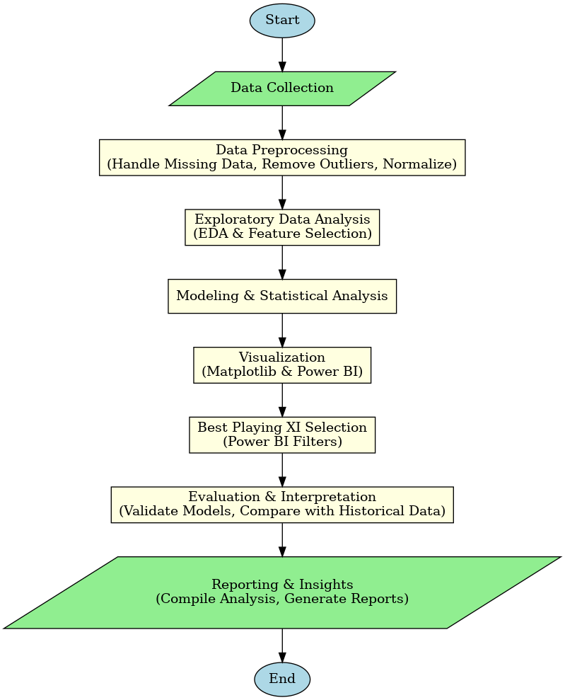
Work Flow

Slide 7
Output
- Visualization of key statistics like matches won, top run-scorers, wickets distribution.
- Best Playing XI selection using Power BI.
- Actionable insights into team performance and selection.

Slide 8
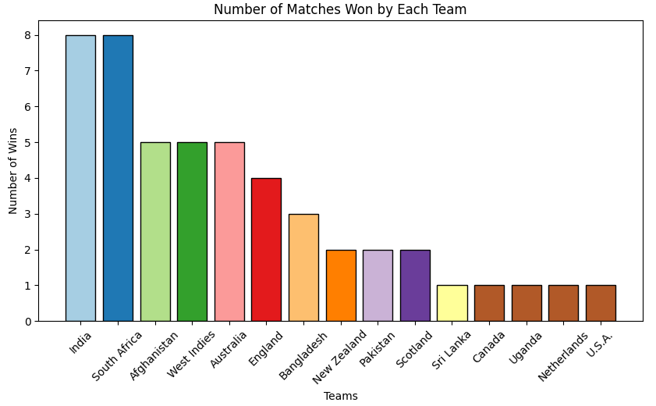
Output
Matches Won by Each Team (Bar Chart)

Slide 9
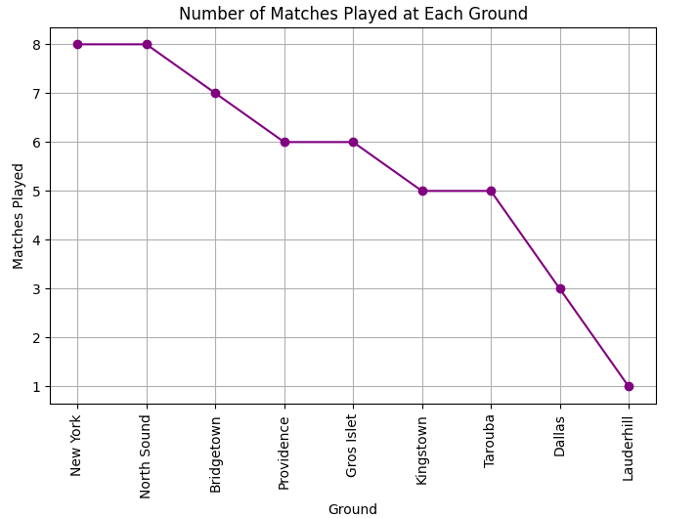
Output
Wins by Ground (Pie Chart)

Slide 10
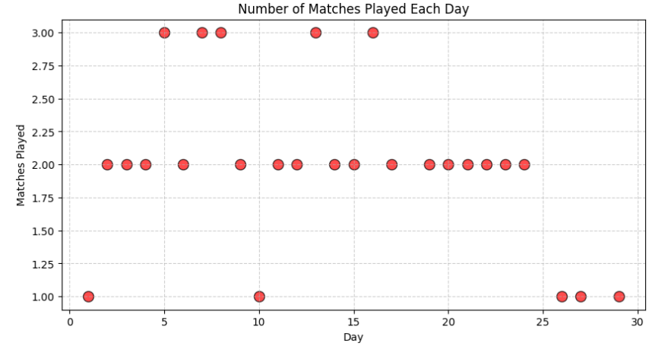
Output
Wins Over Day (Scatter Chart)

Slide 11
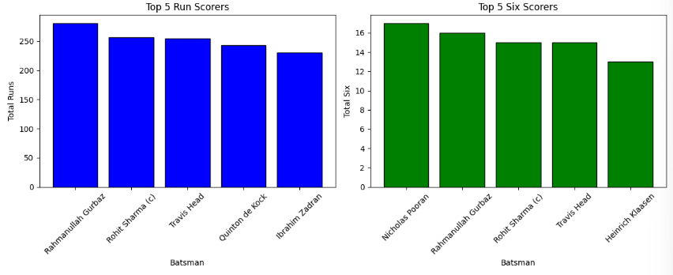
Output
Top 5 Run Scorers, Top 5 Six Hitters (Subplots)

Slide 12
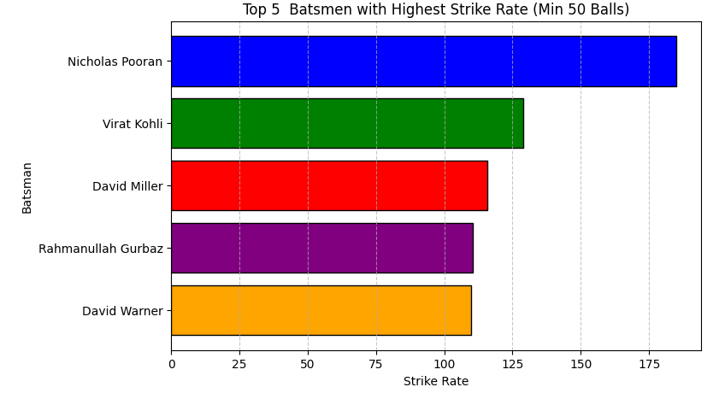
Output
Highest Strike Rate (Horizontal Bar Chart)

Slide 13
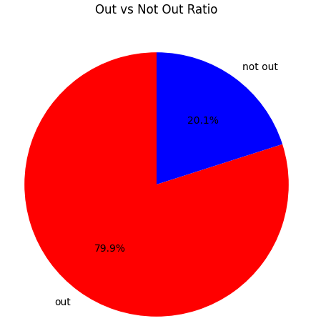
Output
Out vs Not Out Ratio (Pie Chart)

Slide 14
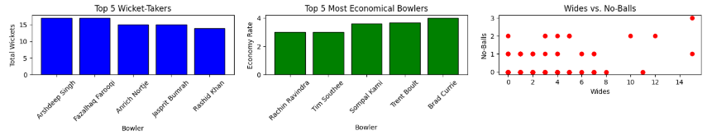
Output
Subplots (Bar chart, Scatter Chart)

Slide 15
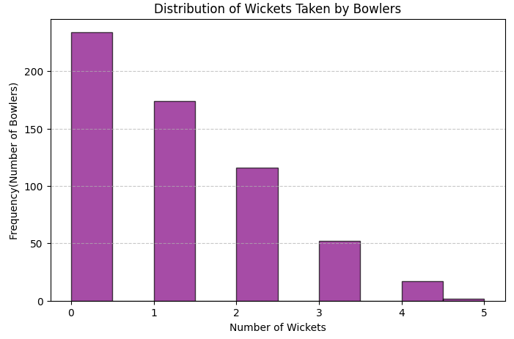
Output
Wickets Distribution (Histogram)

Slide 16
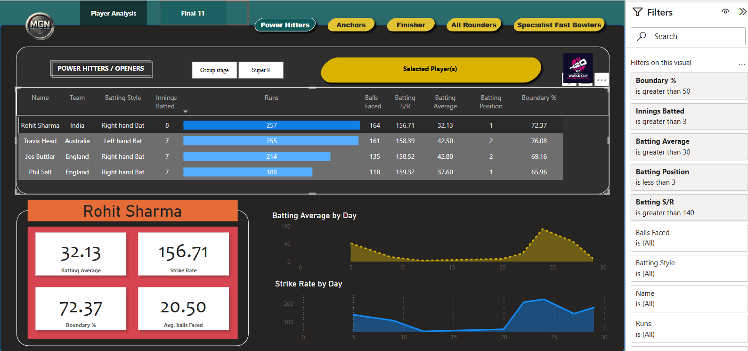
Output
Power Hitter/ Openers Page

Slide 17
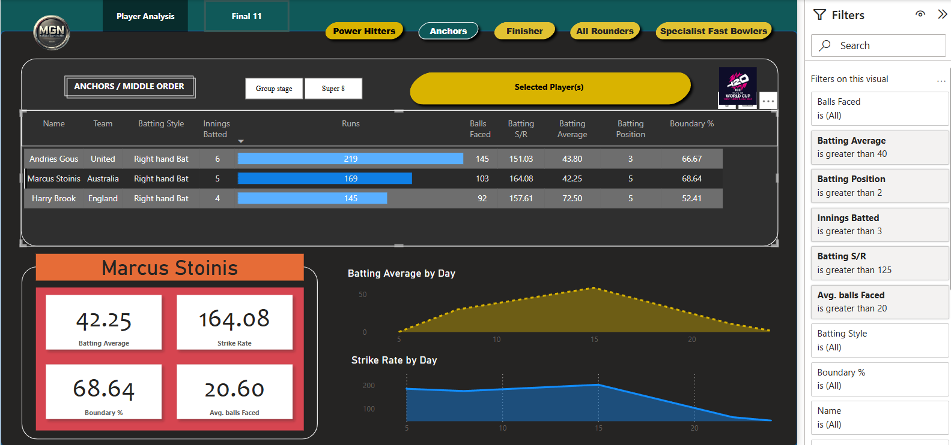
Output
Anchors/ Middle Order Page

Slide 18
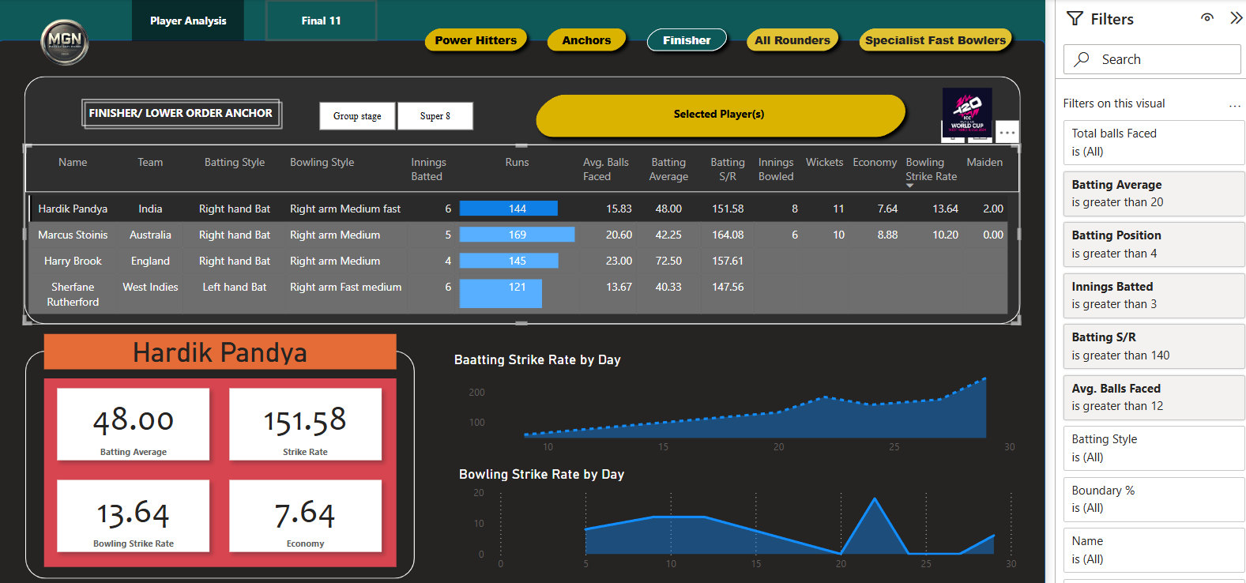
Output
Finisher/ Lower Order Anchor Page

Slide 19
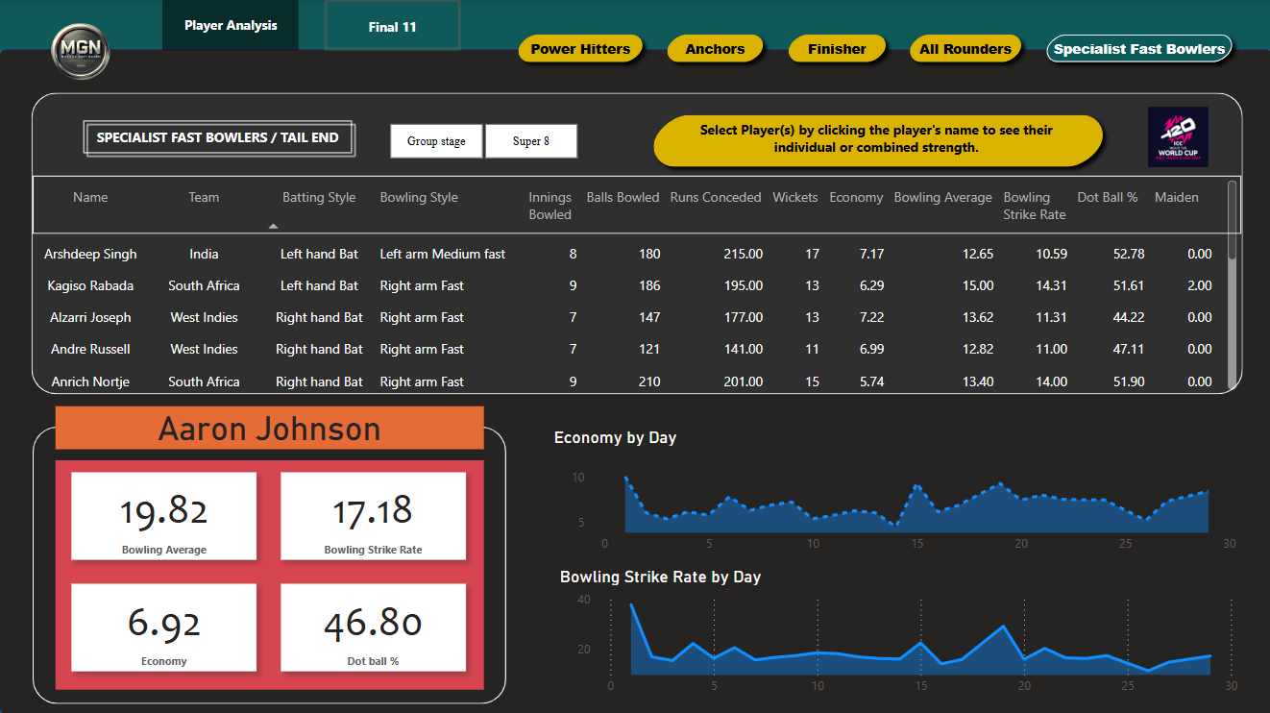
Output
Specialist Fast Bowlers/ Tail End Page

Slide 20
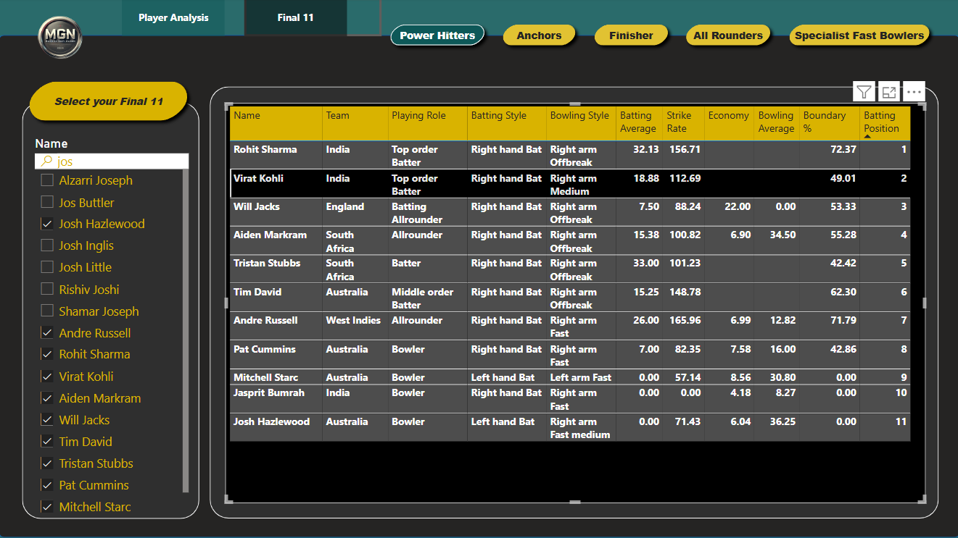
Output
Best Playing XI Page

Slide 21
Future Enhancements
Integrate machine learning models for performance prediction.
Real-time data analysis from live match statistics.
Expand to include player fitness and injury data.
Improve interactive dashboards with more dynamic features.

Slide 22
Conclusion
The project provides valuable insights into cricket performance.
It helps in making data-driven decisions for team selection.
Visualization and interactive dashboards aid in better decision-making.

